Slide 1
Chapter 1: Computer Fundamentals
Basic Concepts & Computer Evolution

Slide 2
Computer Architecture
Computer Architecture is a blueprint for design and implementation of a computer system.
It provides the functional details and behaviour of a computer system and comes before computer organization.
Architecture is those attributes visible to the programmer
Computer architecture deals with 'What to do?'

Slide 3
Computer Organization
Computer Organization is how operational parts of a computer system are linked together.
It implements the provided computer architecture.
Organization is how features are implemented
Computer organization deals with 'How to do?'

Slide 4
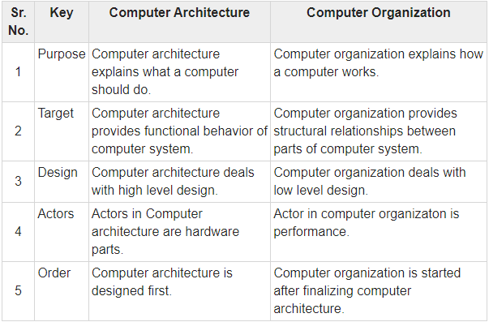
Differences

Slide 5
Functional Units of a computer
Arithmetic
Input
and
logic
Memory
Output
Control
I/O
Processor

Slide 6
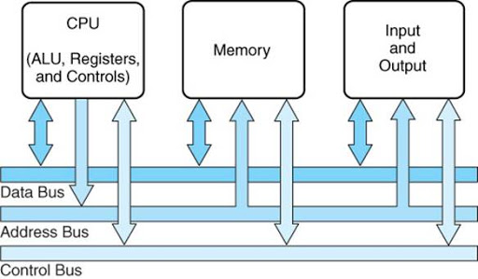
The System Bus

Slide 7
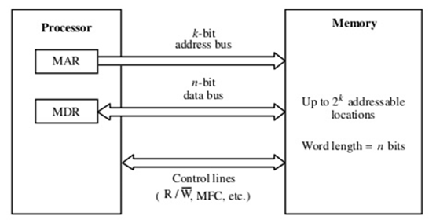
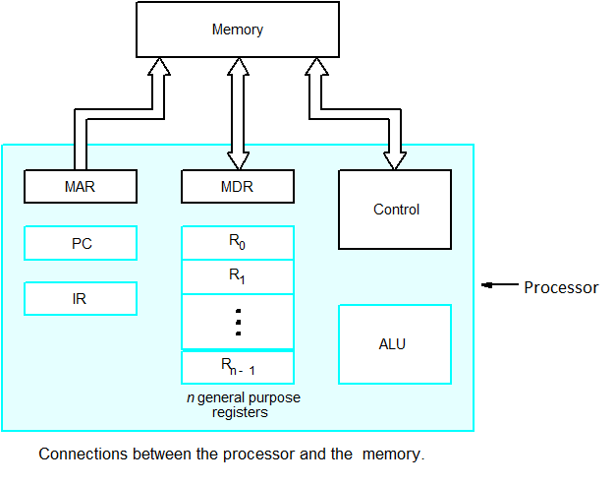
Connection of the memory to the processor
What is an accumulator?
The Accumulator (Register A) is the main register concerned with arithmetic and logical operations because the result of nearly all such actions is loaded into the accumulator
MAR→ Memory Address Register
MDR→ Memory Data Register
PC→ Program counter
IR→ Instruction Register

Slide 8
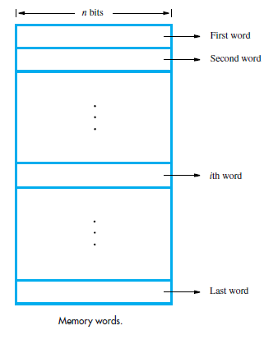
Memory organization

Slide 9
Structure
Structure is the way in which components relate to each other
There are four main structural components:
  Central processing unit (CPU)
  Main memory
  I/O
  System interconnection

Slide 10
Structure - Top Level
Peripherals
Computer
Central
Processing
Unit
Main
Memory
Computer
Systems
Interconnection
Input
Output
Communication
lines

Slide 11
Structure - The CPU
CPU
Computer
Arithmetic
and
Login Unit
I/O
Registers
System
Bus
CPU
Internal CPU
Interconnection
Memory
Control
Unit

Slide 12
Structure - The Control Unit
Control Unit
CPU
ALU
Sequencing
Logic
Internal
Bus
Control
Unit
Control Unit
Registers and
Decoders
Registers
Control
Memory

Slide 13
Function
Function is the operation of individual components as part of the structure
All computer functions are:
  Data processing
  Data storage
  Data movement
  Control

Slide 14
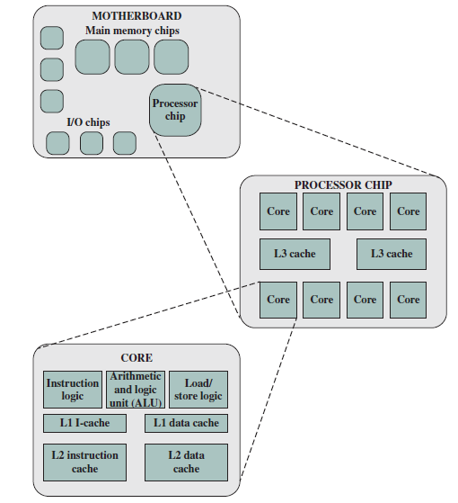
Simplified View of Major Elements of a Multicore Computer

Slide 15
Performance Issues

Slide 16
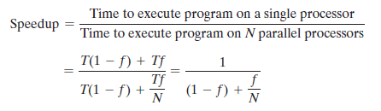
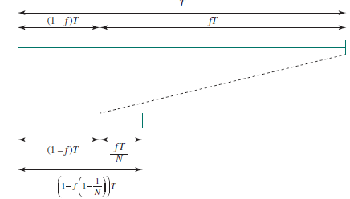
Amdahl’s Law
f → fraction of execution time for parallelizable code
(1-f)→ fraction of execution time for sequential
N→ Number of Processors
T →Total execution time of the program using a single processor

Slide 17
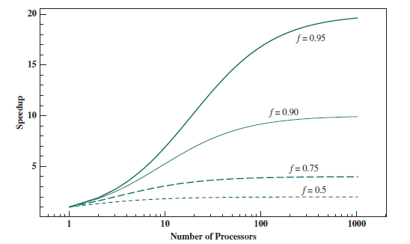
Amdahl’s law for multiprocessors

Slide 18
Little’s Law
L = λW
λ→average rate of arrival of items per unit time
W→units of time the items stay in the system
L→units in the system at any one time

Slide 19


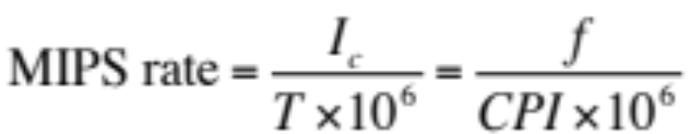
Basic Measures of Computer Performance
Clock Speed
Instruction execution Rate
p→ is the number of processor cycles needed to decode and execute the instruction
m→ number of memory references
k→ the ratio between memory cycle time and processor cycle time

Slide 20
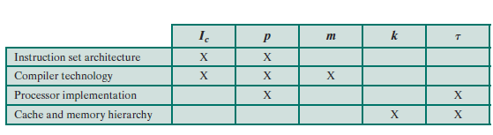
Performance Factors and System Attributes

Slide 21
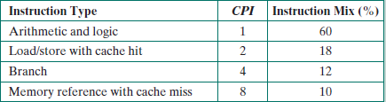
Example 1
Consider the execution of a program that results in the execution of 2 million instructions on a 400-MHz processor. The program consists of four major types of instructions. The instruction mix and the CPI for each instruction type are given below, based on the result of a program trace experiment: Determine the CPI, MIPS rate and execution time for this program.

Slide 22
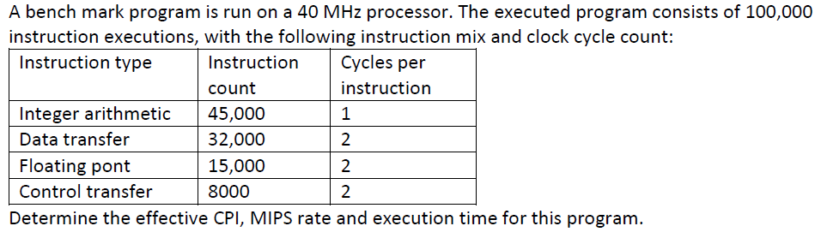
Example 2

Slide 23
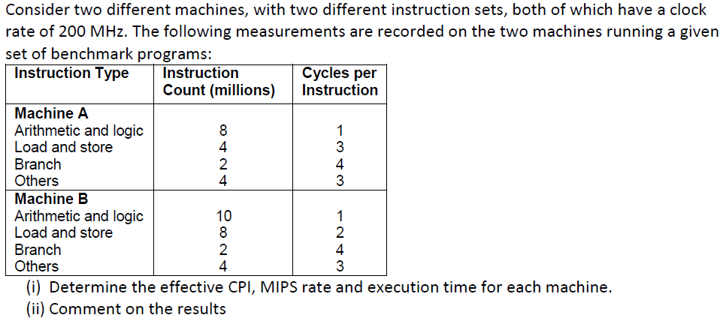
Example 3

Slide 24
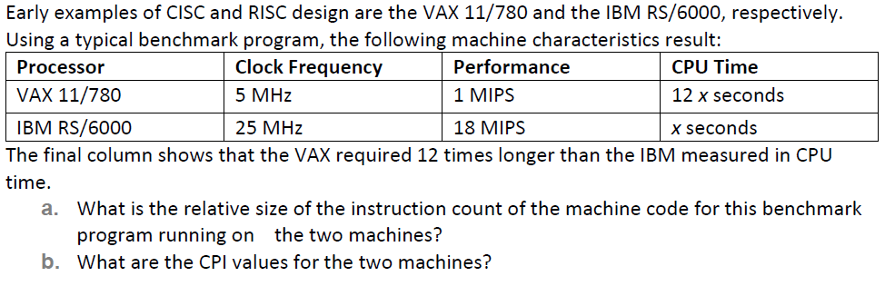
Example 4

Slide 25

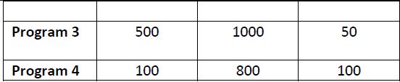
Example 5
Four benchmark programs are executed on three computers with the following results: The table shows the execution time in seconds, with 100,000,000 instructions executed in each of the four programs. Calculate the MIPS values for each computer for each program. Then calculate the arithmetic and harmonic means assuming equal weights for the four programs, and rank the computers based on arithmetic mean and harmonic mean.

Slide 26
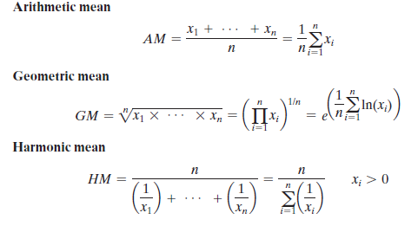


Calculating the Means

Slide 27
Top Level View of Computer Function and Interconnection

Slide 28
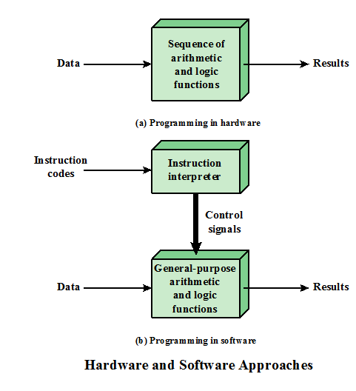
Computer Components

Slide 29
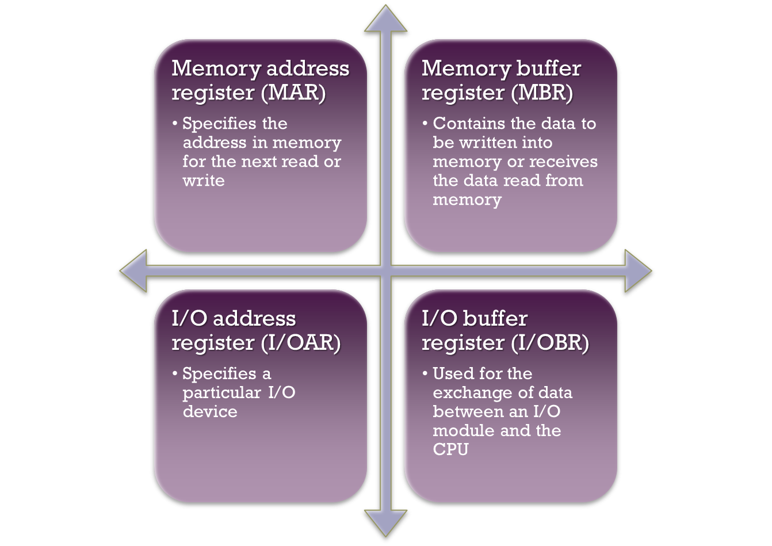

Slide 30
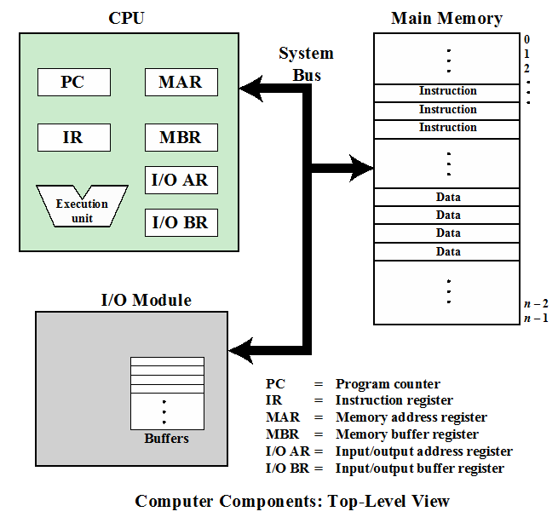
Computer Function:
Instruction Fetch and Execute

Slide 31
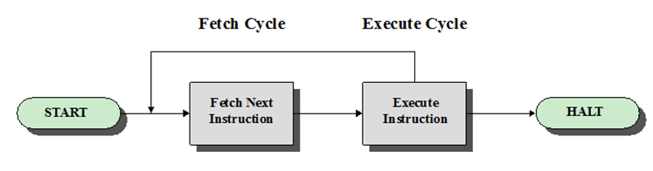
Basic Instruction Cycle

Slide 32
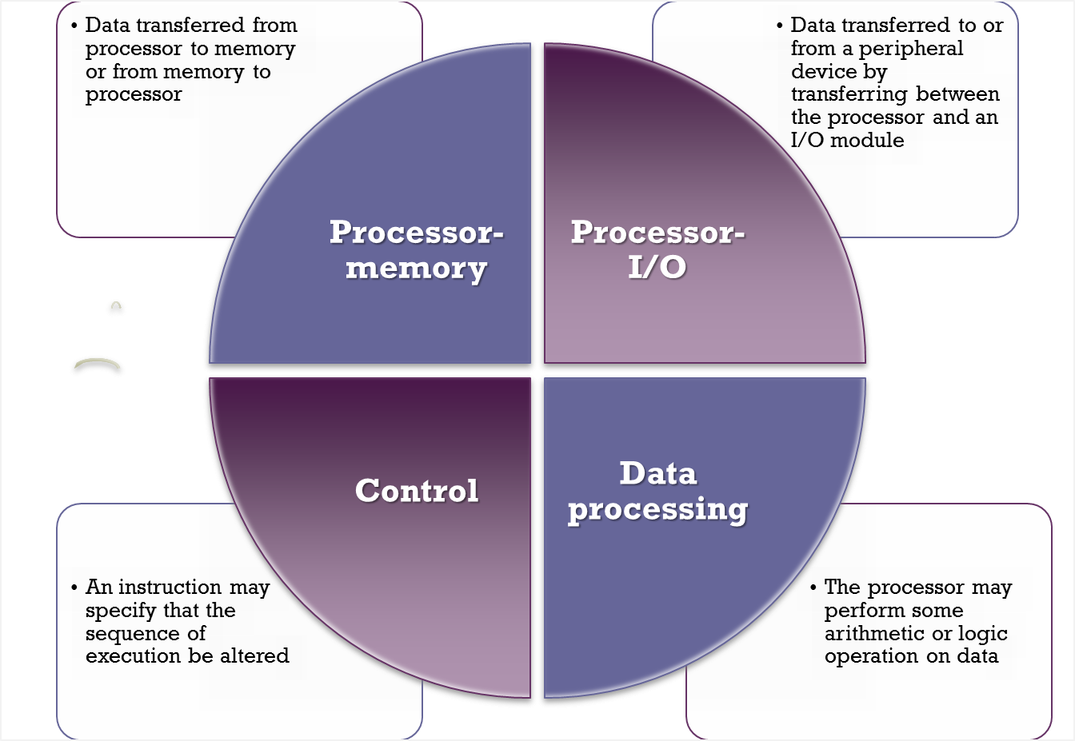

Slide 33
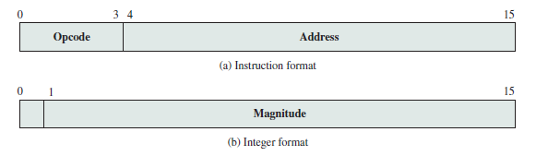
Characteristics of a Hypothetical Machine

Slide 34
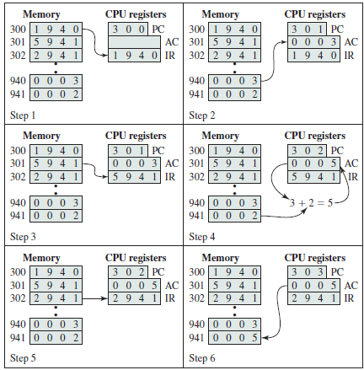

Characteristics of a Hypothetical Machine

Slide 35
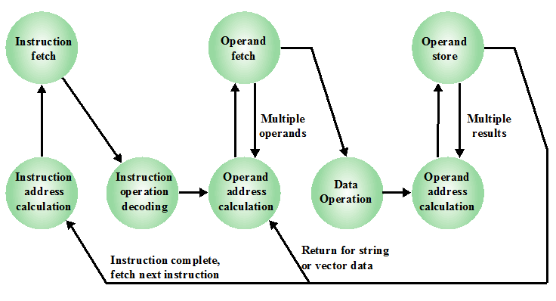
Instruction Cycle State Diagram

Slide 36
Interrupts

Slide 37
Functions of Interrupts
An interrupt allows some module (I/O, memory) to stop the normal processing of the processor
Interrupts are a way to improve processing efficiency
Interrupts are also used to stop a process when some type of error has occurred

Slide 38
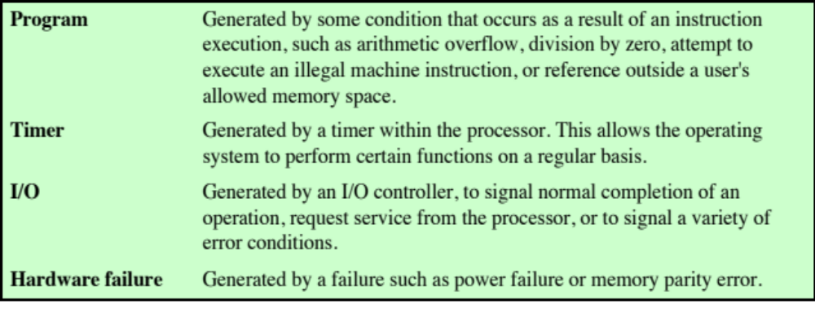
Classes of Interrupts

Slide 39
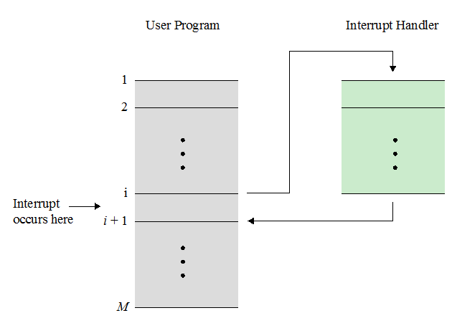
Transfer of Control via Interrupts

Slide 40
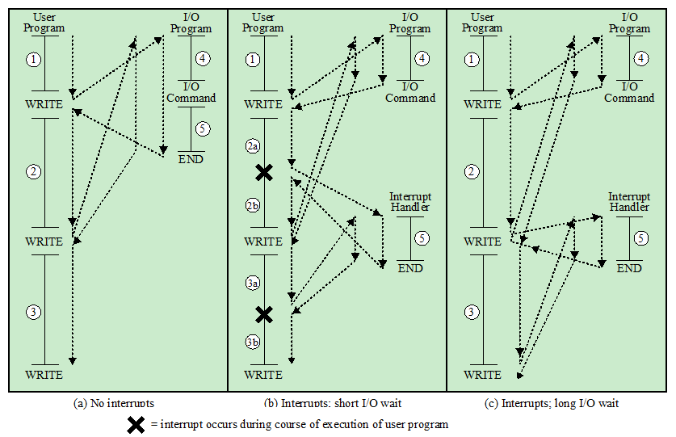
Program Flow of Control without and with Interrupts

Slide 41
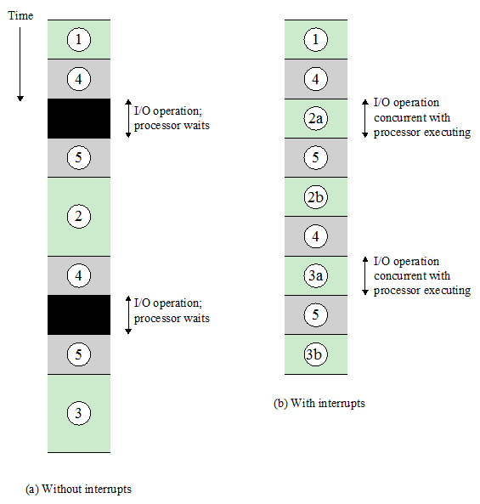
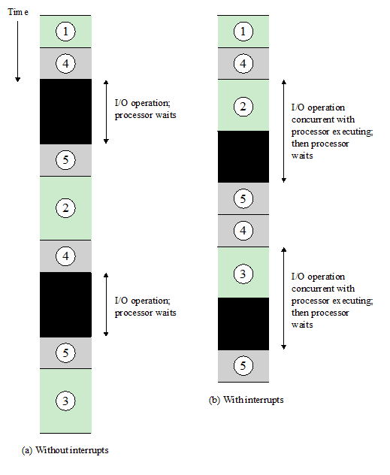
Program Timing:
Short I/O Wait
Long I/O Wait

Slide 42
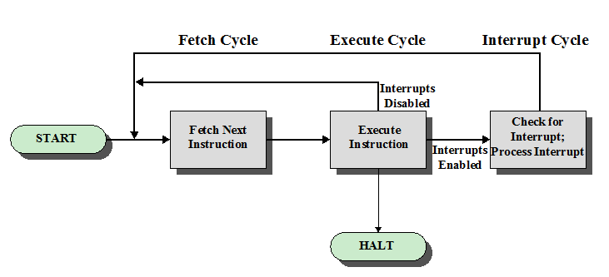
Instruction Cycle with Interrupts

Slide 43
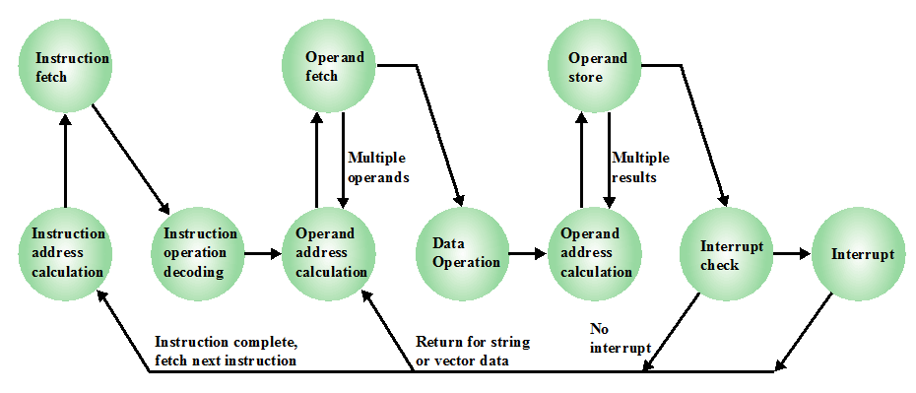
Instruction Cycle State Diagram, with Interrupts

Slide 44
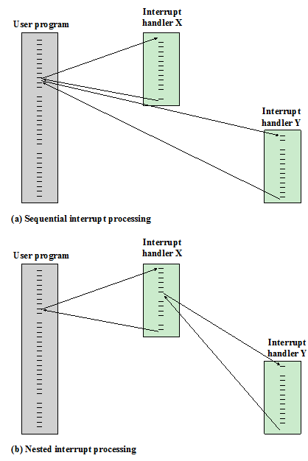
Multiple Interrupts

Slide 45
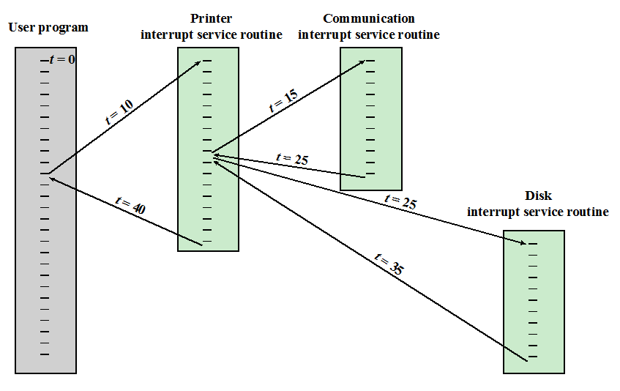
Priority Interrupts
Device | Priority | Arrival of interrupt time ‘t’
Printer | 2 (low) | 10
Disk | 4 | 20
Communications Line | 5 (High) | 15

Slide 46
Interconnection structure

Slide 47
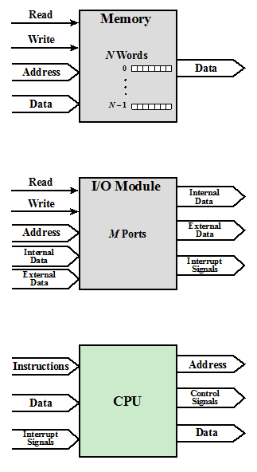
Interconnection Structures

Slide 48
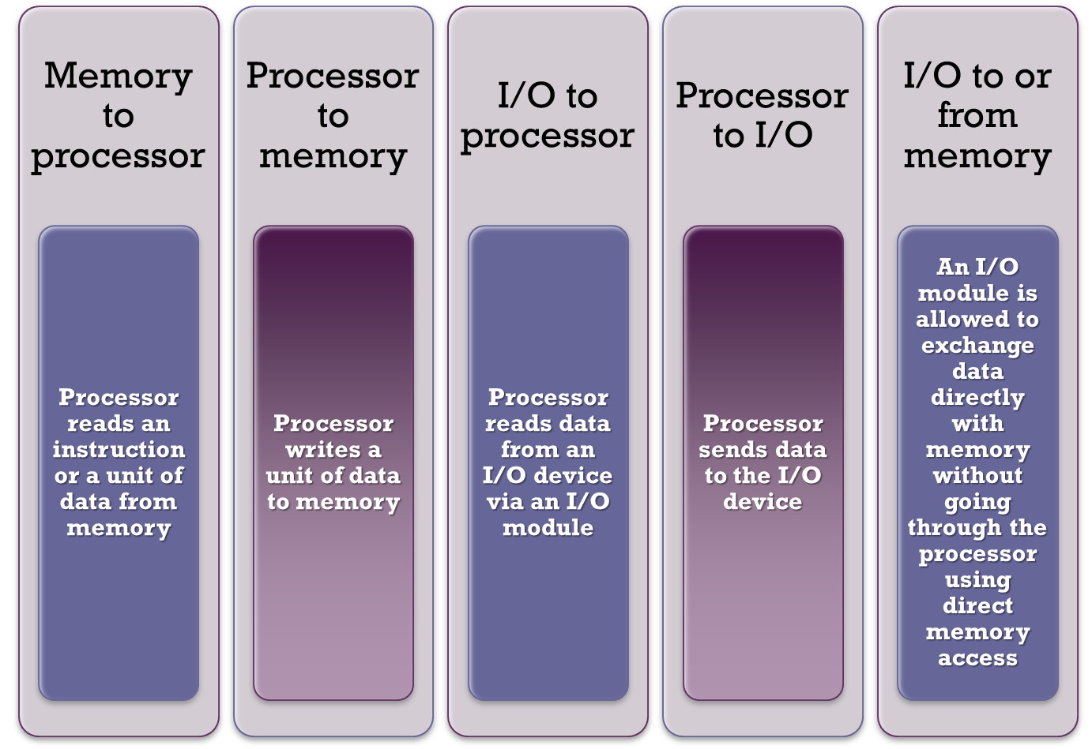
The interconnection structure must support the following types of transfers:

Slide 49
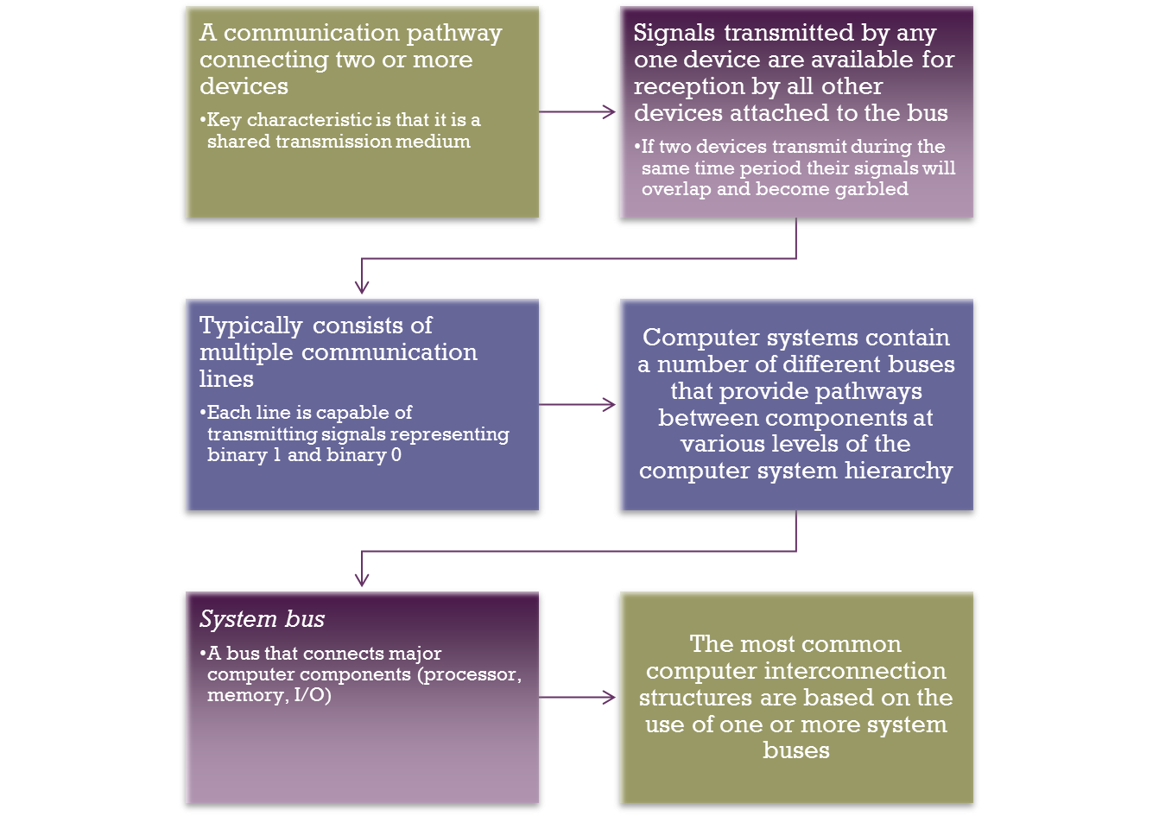

Bus Interconnection

Slide 50
Types of Buses
Data Bus
Address Bus
Control Bus

Slide 51
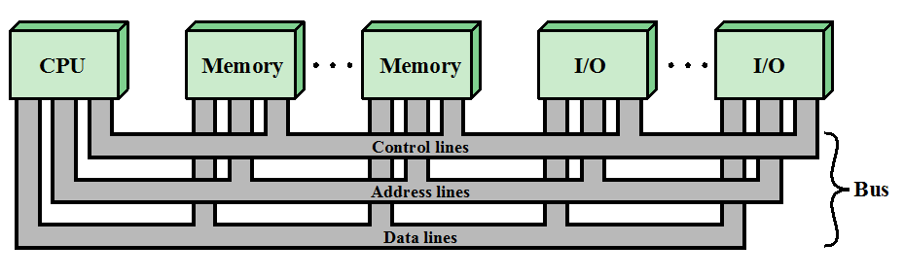
Bus Interconnection Scheme

Slide 52
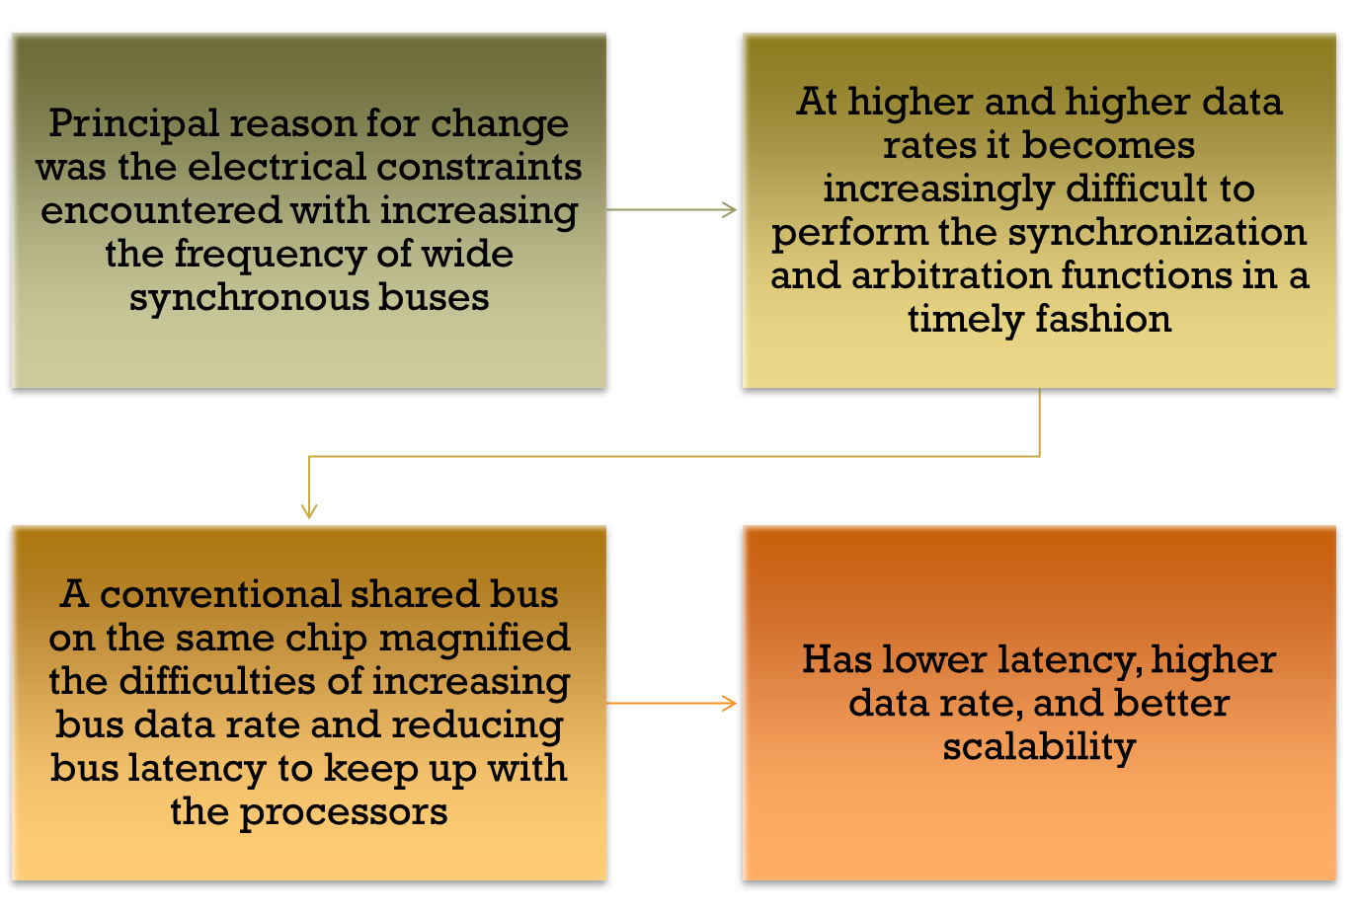
Point-to-Point Interconnect

